Slide 1


HIRING
WARS
WRAP_________________
EPISODE II
Heather Rae Hodgeson
Northern Arizona University

Slide 2
Not so long ago, in three states far, far away, various colleges compete for the brightest and best faculty members to join their ranks. Much will depend on the ease with which these Jedi Masters may align forces and what kind of benefits await them.

Slide 3

School Selection
Based on the 2014 rankings of Average Salaries of Public Schools by the National Educational Association, schools were selected from states with the following ranks:
  1st (highest)– New York- $75,279
  25th (median)– Iowa- $50,946
  50th (lowest) – South Dakota- $39,018

Slide 4

And The Contestants are…
Borough of Manhattan Community
College
    New York, New York
    (2-year)
Iowa State University
    Ames, Iowa
    (4-year)
Sisseton Wahpeton College
    Agency Village, South Dakota
    (2-year)

Slide 5


Borough of Manhattan Community College
Location: New York, New York
Established: 1963
Degrees and Programs offered: 32
Enrollment: 23,158
Faculty: 414 f/t, 790 p/t
Area: Urban/metro (pop ~8.4 million)
Website: http://www.bmcc.cuny.edu/j2ee/index.jsp

Slide 6
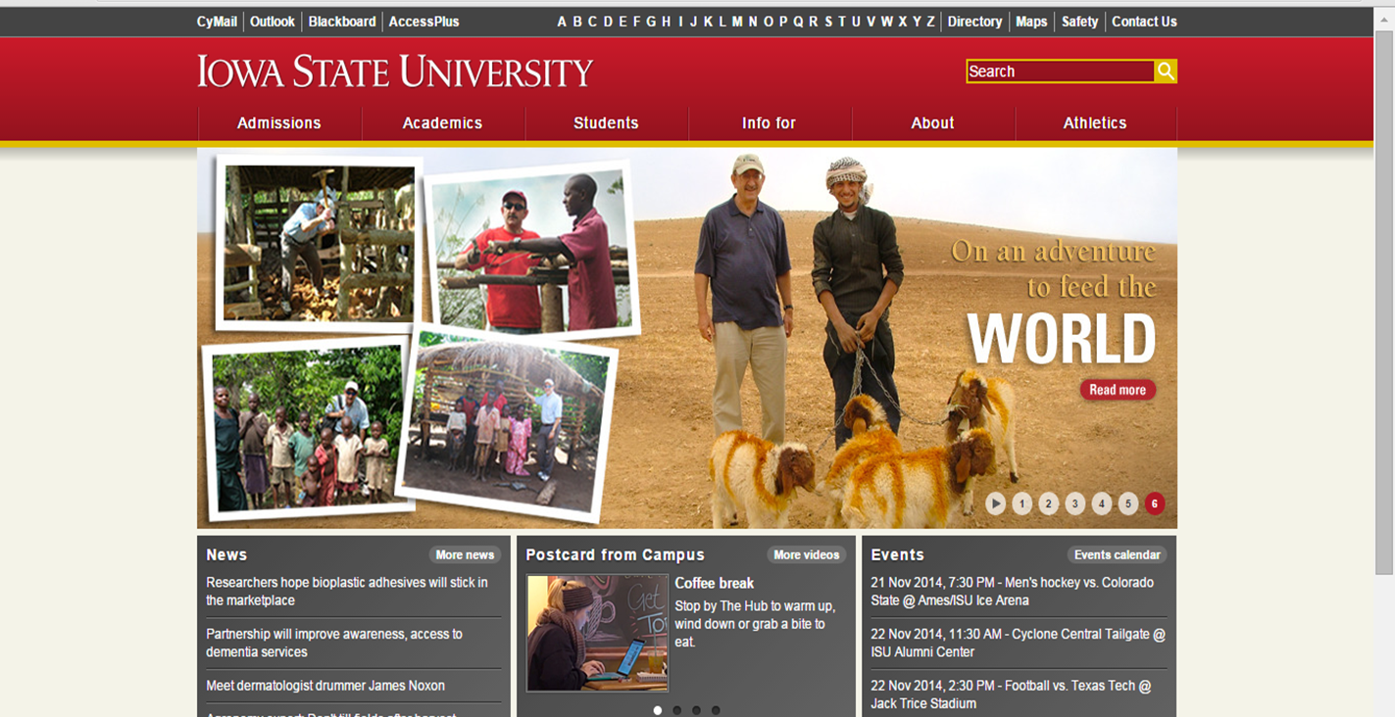
Iowa State University
Location: Ames, Iowa
Established: 1858
Degrees and Programs offered: >100
Enrollment: 33,241
Faculty& Staff: 6,300
Area: Urban (population ~61,000)
Website: http://www.iastate.edu/

Slide 7

Sisseton Wahpeton College
Location: Agency Village, SD
Established: 1979
Degrees and Programs offered: 18 Associates & 4 Certificates
Enrollment: 260
Faculty& Staff: 20
Area: Rural (population ~2,400)
Website: http://www.swc.tc/

Slide 8
School Comparisons
School | Tuition | Ease of Finding Job Info | Governance
Borough of Manhattan Community College | Resident- $1,990 Non-Res -$5,970 | Easy (2 ‘clicks’ from homepage) | Part of State University of New York system (2-year campuses)
Iowa State University | Resident- $16,600 Non-Res- $29,490 | Moderate (5 ‘clicks’ from homepage) | University of Iowa state system
Sisseton Wahpeton College | ISC funded-$1380 Non ISC-$ $1500 | Easy (2 ‘clicks’ from homepage) | Tribally Controlled College

Slide 9
Job Comparison
School | Job Title | Salary
Borough of Manhattan Community College | Full Professor-Media Arts and Technology | Assistant Professor: $42,873 to $74,133 Associate Professor: $55,602 to $88,418 Professor: $68,803 to $106,071
Iowa State University | Full Professor in Statistical Bioinformatics | Commensurate with qualifications
Sisseton Wahpeton College | Business Instructor | DOE

Slide 10
Job Comparison—Qualifications
School | Minimum | Preferred
Borough of Manhattan Community College | Ph.D. degree in area(s) of experience or equivalent. | For Associate Professor and Professor, the candidate must have significant record of achievement in the field. Two years' experience teaching successfully in a college environment. Demonstrated technical ability in at least one area of video production or animation required.

Slide 11
Job Comparison—Qualifications
School | Minimum | Preferred
Iowa State University | Ph.D. in statistics, bioinformatics, or a closely related field. | Associate and Full Professor: In addition, the candidate must have documented teaching experience commensurate with university standards and an outstanding research record as demonstrated by peer-reviewed publications and external research support or equivalent experience at corporate or federal research centers.

Slide 12
Job Comparison—Qualifications
School | Minimum | Preferred
Sisseton Wahpeton College | Bachelor’s Degree in Business/ Accounting | Master’s degree in Business/Accounting 18 credits in Accounting/tx. Planning, organizational, and time management skills Ability to work as a team player Proficient with office software, Microsoft Word, Excel, PowerPoint, etc. Proficient with office machinery Proficient with Federal Income tax software. Three-years experience in Federal Income tax preparation in personal, business and corporation

Slide 13
Job Comparisons
School | Tenure-Eligible | Workload (hrs/wk, mo/yr) | Workload (credits/contact hrs) | Benefits
Borough of Manhattan Community College | Yes (with re-appointment/promotion) | Full Time 35 hrs/week 9 mo/yr | 24 contact hrs | Health/dental/vision/life insurance Pension Retirement Paid parental leave Savings programs
Iowa State University | Yes | Full Time 40 hrs/week 9 mo/yr | 24 contact hrs | Health/dental/vision/life insurance Retirement Options
Sisseton Wahpeton College | Yes | Full Time 40 hrs/week 9 mo/yr | 12 to 15 credit or 24 contact hours | Health/dental/vision/life insurance Retirement Fringe Benefits

Slide 14
Job Comparisons
School | Duties and Responsibilities
Borough of Manhattan Community College | Performs teaching, research and guidance duties in area(s) of expertise. Shares responsibility for committee and department assignments including administrative, supervisory, and other functions. Campus Specific: Performs teaching, research and guidance duties in the area of expertise. Shares responsibility for committee and department assignments including administrative, supervisory and other functions. Teaches introductory course(s) in media studies such as Introduction to Moving Image, Scriptwriting, and Introduction to Contemporary Media. Also teaches production courses in Video Production or Animation. Participates in department and college activities, such as curriculum development, grant writing , assessment, faculty development, and mentoring student projects. Productive scholarship is expected. Evening/weekend schedule may be required.

Slide 15
Job Comparisons
School | Duties and Responsibilities
Iowa State University | Duties include teaching undergraduate and graduate level courses, graduate student advising, professional and institutional service, developing and sustaining a high-impact research program that can successfully compete for external funding, and participating in collaborative research to address scientific problems involving bioinformatics and computational biology. Other duties include: directing undergraduate and graduate projects, internships, theses, and dissertations; serving on masters and doctoral committees; advising and mentoring undergraduate students, graduate students, and post-doctoral associates; teaching assignment and responsibilities; advising activities; direction of masters and doctoral candidates; service on masters and doctoral committees; training and mentoring activities; curricular development activity; grant activity; leadership positions; service in professional societies, organizations and events

Slide 16
Job Comparisons
School | Duties and Responsibilities
Sisseton Wahpeton College | 1. Assist students who have problems with assignments, tests, grades, course content, career concerns, and other academic matters. 2. The acquisition of knowledge to improve level of understanding and sensitivity to the Dakota Culture as it relates to students performance. 3. Regular reporting to Lead Business Instructor on students, budgets, and curriculum matters. 4. Maintains accurate student records, attendance, emphasizing to students the importance of regular attendance and its relevancy to satisfactory performance. 5. Develops and maintains curriculum in areas of instructional deliver. Be familiar with curriculum contents of the course. 6. Continuous effort to improve course content including the development and use of audio/multi-media, computer application and other hands-on activities as appropriate to the course. 7. Complies with all College, Tribal, and Federal policies, regulations and laws that govern the college. 8. Participates on College Committees and in faculty/staff meetings. 9. May be required to assist with events. 10. Performs other duties as assigned.

Slide 17

Thank You
For your consideration…

Slide 18
References
School Websites:
Borough of Manhattan Community College. http://www.bmcc.cuny.edu/j2ee/index.jsp
Iowa State University
http://www.iastate.edu/
Sisseton Wahpeton College
http://www.swc.tc/
Other:
National Educational Association. (2014). Average Salaries of Public
Schools. Rankings of the States 2013 and Estimates of School Statistics . (2014). Retrieved from: http://www.nea.org/assets/docs/NEA-Rankings- and-Estimates- 2013-2014.pdf

Slide 19
References con’t
Images:
http://thehdwall.com/wp-content/uploads/2014/07/Space-Stars-Star-Wars-Sci-Fi-Planets-Planet-Desktop-Backgrounds.jpg
http://www.motionbackgroundsforfree.com/wp-content/uploads/2012/04/Screen-shot-2012-04-13-at-2.24.50-PM.png
http://premiumcoding.com/beautiful-free-space-backgrounds/
http://offroaduruguay.org/img/space-background.html
http://bigbackground.com/space/colorful-space-background.html
http://www.bluewallpaper.org/wallpaper/Star-Wars-Background/
http://wall.alphacoders.com/by_sub_category.php?id=172083
https://www.google.com/search?q=space+background
http://media.cdn.impericon.com/media/impericon/category/merch/starwars/20121204_star_wars_background.jpg
Audio:
Starwars 1 MPEG 4
Stirling, L. & Hollens, P. (2013). Star Wars Medley [Single]. Retrieved November 2014 from: http://www.youtube.com/watch?v=KtQb2axKpuw
http://www.thesoundarchive.com/star-wars.asp
https://ia801703.us.archive.org/15/items/StarWarsThemeSongByJohnWilliams/Star%20Wars%20Theme%20Song%20By%20John%20Williams.mp3
http://www.mediacollege.com/downloads/sound-effects/star-wars/lightsaber/lightsaber_02.mp3
http://www.mediacollege.com/downloads/sound-effects/star-wars/darthvader/darthvader_dontmakeme.wav
http://www.mediacollege.com/downloads/sound-effects/star-wars/darthvader/darthvader_yourfather.wav
http://www.mediacollege.com/downloads/sound-effects/star-wars/r2d2/r2d2_01.wav
http://www.mediacollege.com/downloads/sound-effects/star-wars/chewbacca/chewbacca_01.wav
http://www.mediacollege.com/downloads/sound-effects/star-wars/jabba/jabba_laugh.wav
http://www.mediacollege.com/downloads/sound-effects/star-wars/yoda/yoda_doordonot.wav
http://www.mediacollege.com/downloads/sound-effects/star-wars/yoda/yoda_whyareyouhere.wav

